Slide 1
A G U G A C
A G C G A G
* * * *
A G U G A C
A G C G A G
C A G G A A
U C A G A U
G C C G A U
C U G G A A
* *
U C A G A U
G C C G A U
* * * *

Slide 2
B B C C P N B B N P
A C U G C C G U U C
U G U G G G C A G A
A A U G G A U U C U
C U U G C A A G U G
G A U G A U U C G C
*
*

Slide 3
B B C C P N B B N P
A C U G G C G U U C
U G U G U G C A G A
A A U G A A U U C U
C U U G C A A G U G
G A U G G U U C G C
*
*

Slide 4
Toy MSA figure description without structure:
Multiple Sequence Alignment (MSA) of toy RNA sequence data where columns 4 and 5 show highly conserved nucleotides across all sequences. With pairwise alignments between only two sequences there is a higher chance of finding spurious matches between sequences that may not be actually conserved within the family. Comparing multiple sequences at gives greater confidence in predicting important sites in the molecule that could be implicated in function.
Toy MSA figures description with nested structure:
MSA of toy RNA sequences which have conserved base pairs shown by columns with covarying nucleotides that conserve base pairings. Sites are aligned in columns. Proper alignment of sequences shows the evolutionary conservation of nucleotides across different sequences at similar sites. Columns 3 and 4 show conserved single nucleotides, in which down the column a similar base pair is frequently observed. Two base pairs are shown between sites 1,2 and sites 7,8. These columns individually do not show conservation, but the pairs of nucleotides show conserved base pairings.
Toy MSA figures description with non-nested structure:
The toy MSA from Figure 1 is shown, but a new base pair between sites 5 and 10 is inserted which is non-nested with respect to the other base pairs. This new base pair is not enclosed within or outside of the stem. An SCFG would not be able to model this non-nested base pair and thus would not account for it in making predictions of sequence similarity.
Previous description for toy MSA explaining the difference between nested and non-nested base pairs
MSA of toy RNA sequences which have conserved base pairs shown by columns with covarying nucleotides that conserve base pairings. Columns 3 and 4 show conserved single nucleotides. Two nested base pairs are shown between sites 1,2 and sites 7,8. A non-nested base pair is also seen between the inner loop (site 5 ) and site 10. An SCFG would not be able to model the non-nested base pair and thus would not account for it in making predictions of sequence similarity.

Slide 5
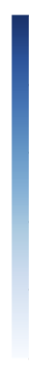

High Score
AGAGCC
AGCGCC
?
AGUGCC
AGGGCC
AGUGCC
WT
Low Score
Notes:
Should I have a visual explaining how First order mutagenesis is done?

Slide 6
First Order Mutagenesis schematic process
Schematic for First Order Mutagenesis on a toy sequence with conserved motif (GUG). For a selected nucleotide site, mutant sequences are generated in silico with every possible mutation at that site. These mutant sequences are tested using a trained NN producing a score for each mutant. If the NN has learned that the nucleotide is important for function, it should give the highest score for the WT nucleotide (U). We repeat this for every site in the sequence producing a mutation score vector for each site. These scores can be visualized as saliency logos depicting the proportional importance of each nucleotide in the sequence. These logos show what the NN has learned about the data allowing comparison with ground truth information to verify if the model is learning relevant biological features.

Slide 7
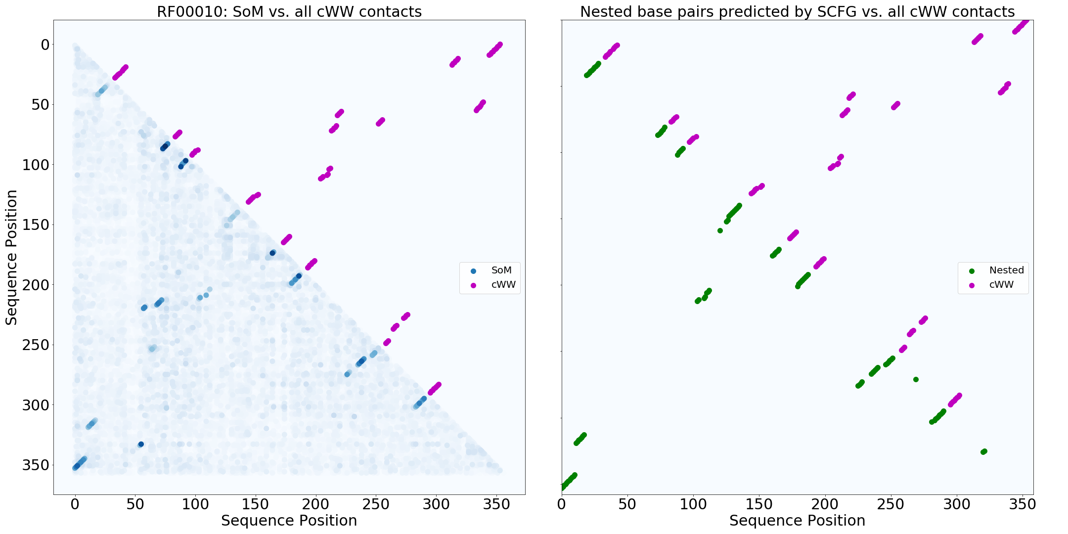

Slide 8
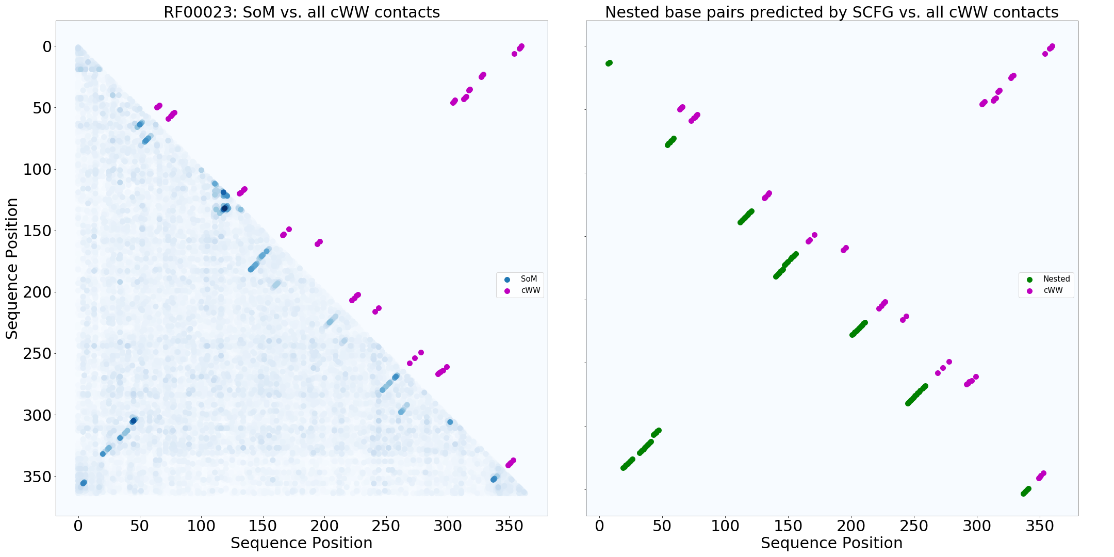

Slide 9
A

Slide 10
B

